Slide 1
Sales Analysis and Prediction
Pethukrishnan

Slide 2
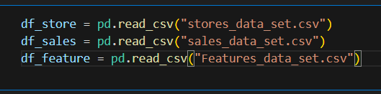
Datasets
We have Three Different Datasets(Store , Sales, Features), each datasets contains different features . we need to merge and display combined datasets.

Slide 3
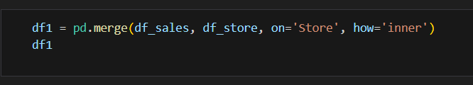

Merge Datasets
Merge 3 datasets based on Store dataset, because 3 datasets contain Store feature.

Slide 4
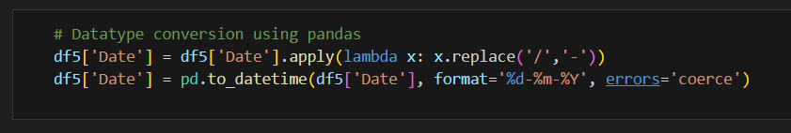
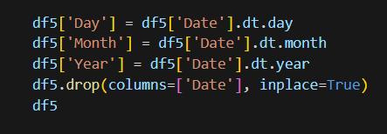
Date Conversion and Split Columns
Date Feature is a Object datatypes, so we need to convert a datetime datatype using pandas.
Split the Date Feature and create a Day , Month, Year features.

Slide 5
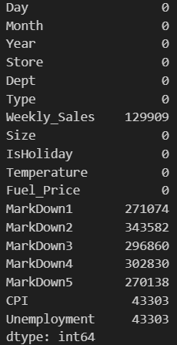
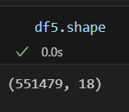
Null values in Features
Finally we have 18 features and 551479 datas, after doing merging and features creation.
Compare the all features, Markdown(1-5) and Weekly_sales has a highest null values, so we need to convert null values into valuable values.
Weekly_Sales also has a negative values too . So we have to convert negative values into null values.

Slide 6
Model Building Steps
We need to create two different models to predict Weekly_sales and compare the Performance of both models.
Model-1 with all markdowns(1-5) to predict the Weekly_Sales
Model-2 without markdowns(1-5) to predict the Weekly_Sales
Train machine learning model and predict markdown(1-5) are all separately. Then add all predicted markdown values into a Dataframe.
Repeat the model and also predict cpi , unemployment , because these features also have huge number null values.
Then Finally have to predict the Weekly_Sales.

Slide 7
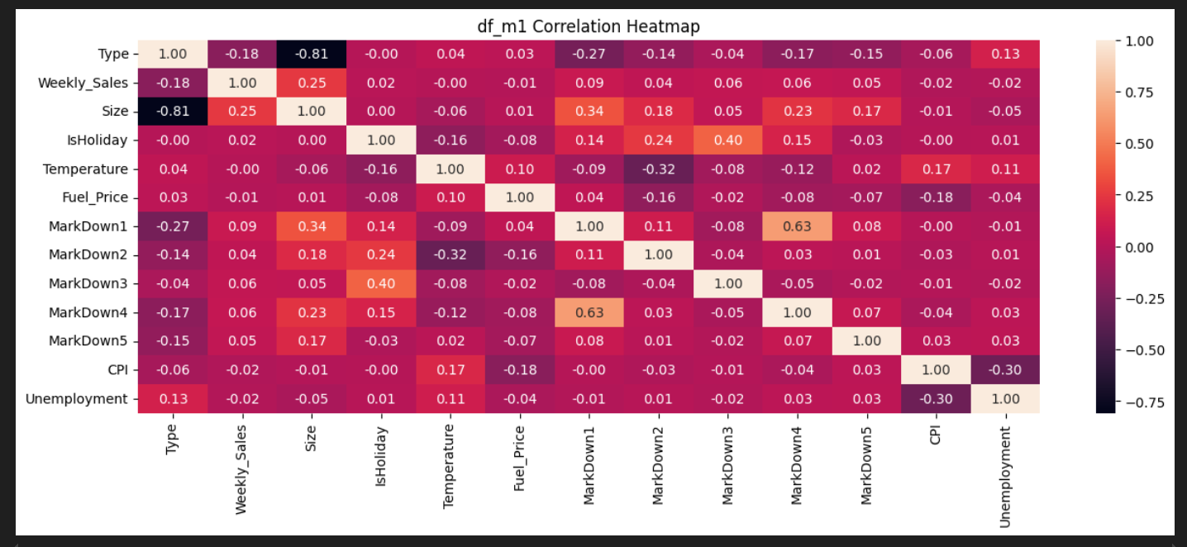
Correlation
This Heatmap shows ‘Type’ and ‘Size’ features have high correlation and also relationship with weekly_sales
Other Features are weak correlation with weekly_sales

Slide 8
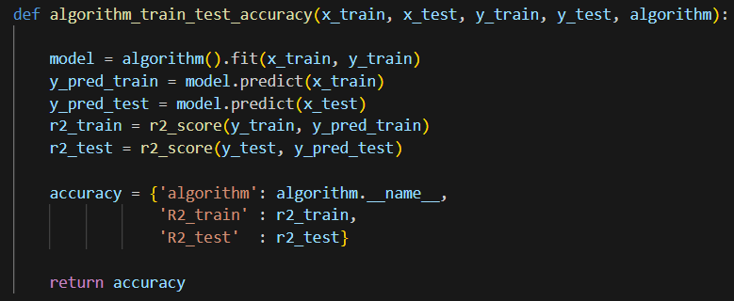
Model Building
This is the supervised learning problems and supervised learning have two types of techniques: Regression and Classification
We have to use regression technique to find a weekly_sales , because target features is a continuous values.
Algorithms
Split the datas and Evalution metrics
DecisionTreeRegressor
ExtraTreesRegressor
RandomForestRegressor
AdaBoostRegressor
GradientBoostingRegressor
XGBRegressor

Slide 9
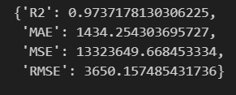
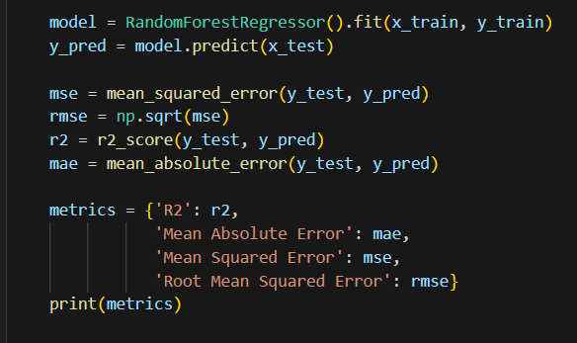
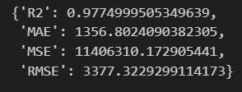
Select Model
RandomForestRegressor algorithm peroform well to predict unseen data.
Model with Markdowns
Model without Markdowns

Slide 10
Conclusions

